Slide 1


Lightweight Attention CNN
for Retinal Vessel Image Segmentation DATE-30-11-2023
Group name - Neural Crew
Group members -
Ankur Kumar Karn (20BCS034)
Anshul Shukla (20BCS035)
Krishna Singh (20BCS119)
Mihir Solanki (20BCS123)
PDPM INDIAN INSTITUTE OF INFORMATION TECHNOLOGY DESIGN AND MANUFACTURING, JABALPUR

Slide 2
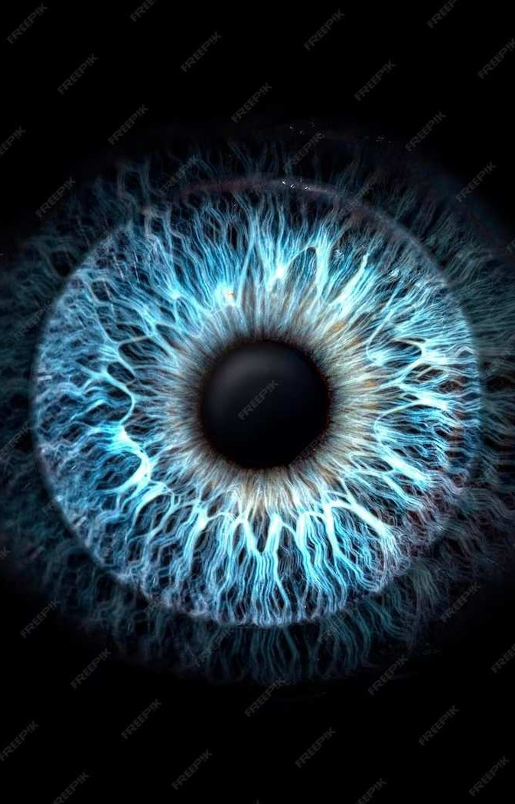
Retinal Vessel Image Segmentation with a Lightweight Attention Convolutional Neural Network

Slide 3
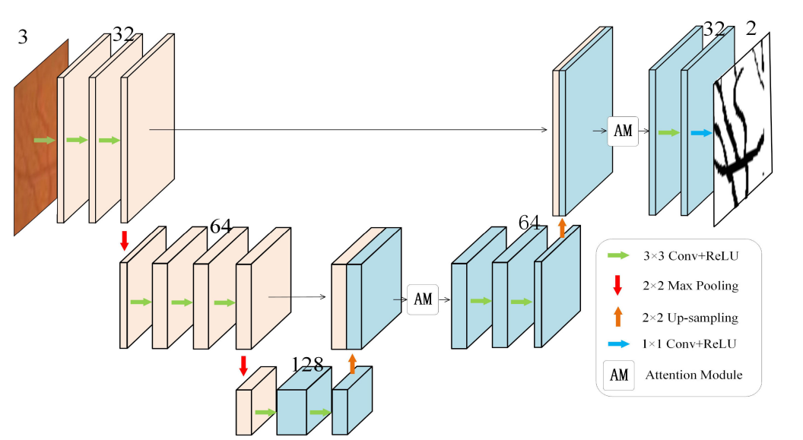
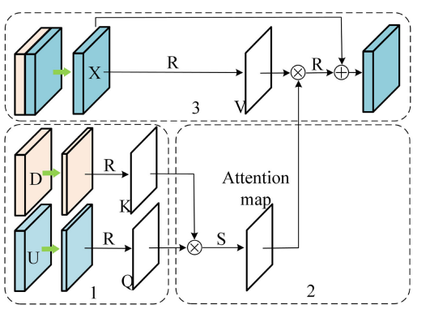
Unet with Attention Module
Propose an attention model integrating U-Net and an attention mechanism–Attention model – special tool added to a regular neural network
Feature Extraction:
Feature Similarity Calculation
Original Feature Enhancement:
Attention module

Slide 4
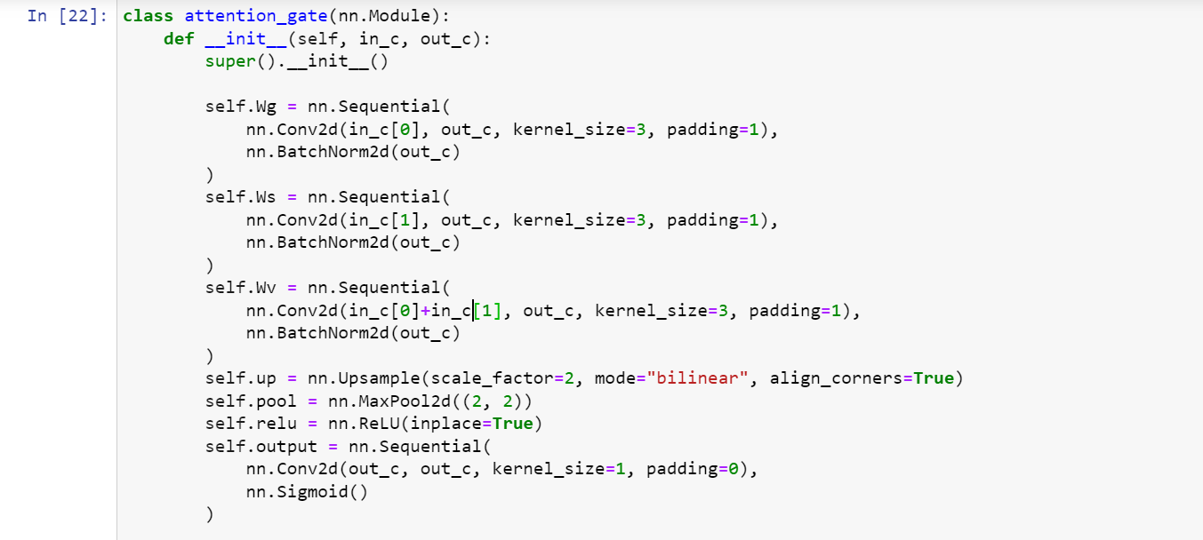
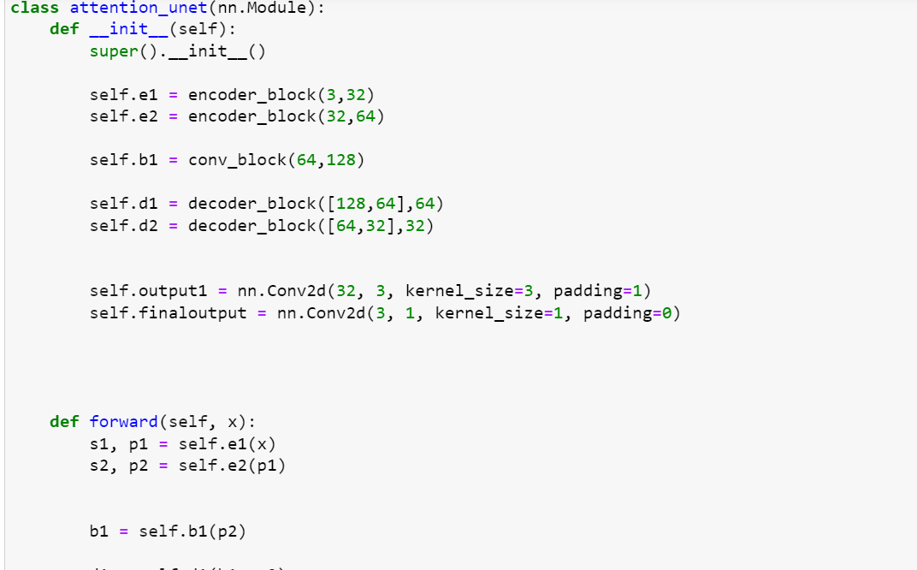
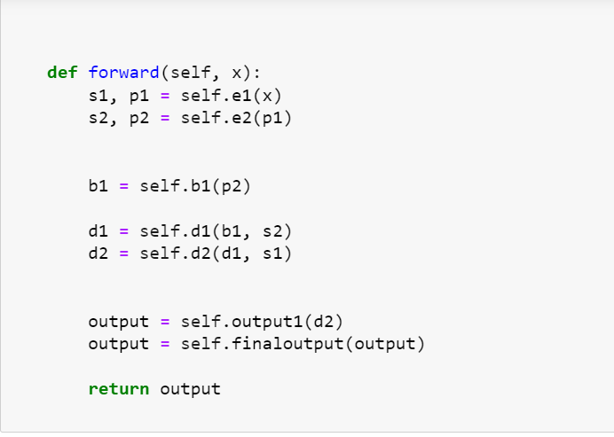
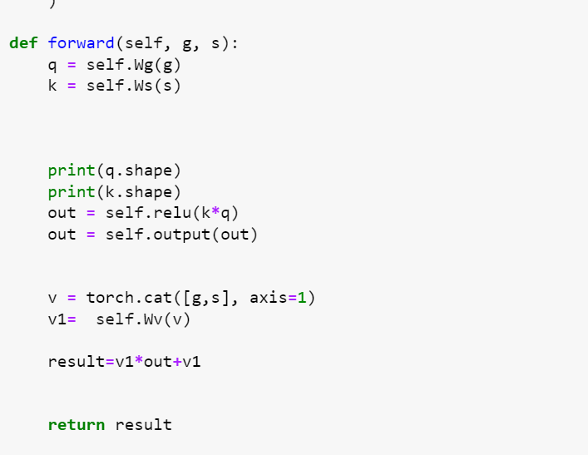
Am module code
Attention unet code

Slide 5
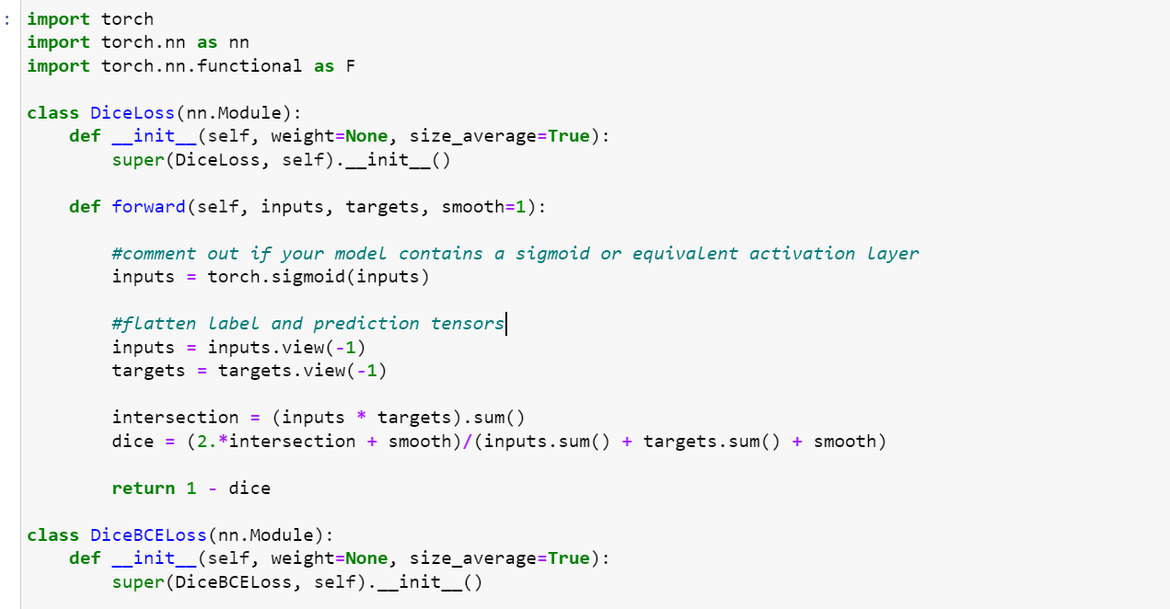
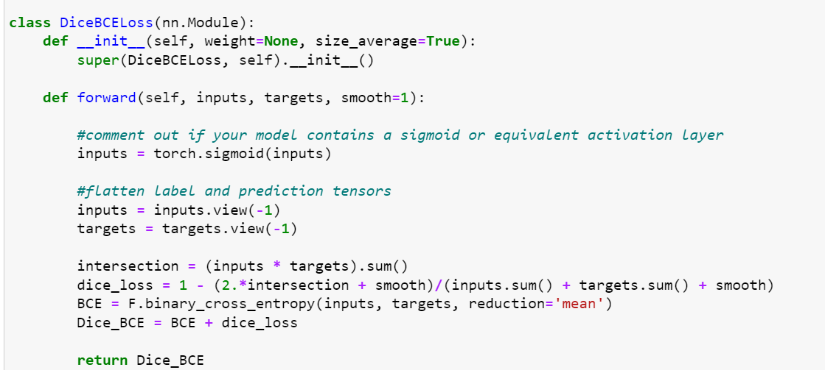
Loss function code
Loss function
BCE + Dice Loss:Dual loss balances edge details and overall segmentation accuracy.
2.Enhanced Segmentation:Combines boundary detail preservation and segmentation refinement effectively.
3.Fine Boundary Control:Facilitates sharp edge prediction and global feature alignment.

Slide 6
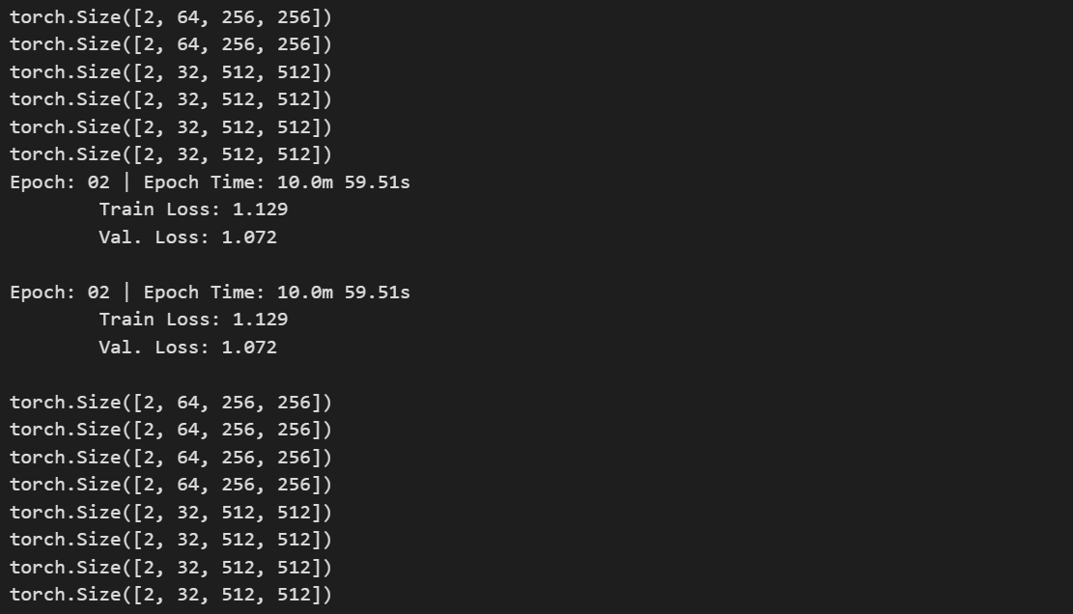
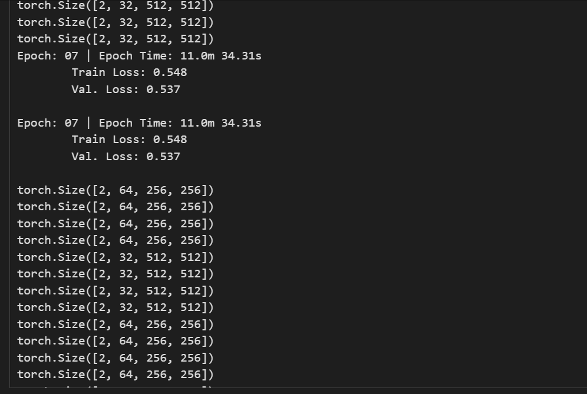
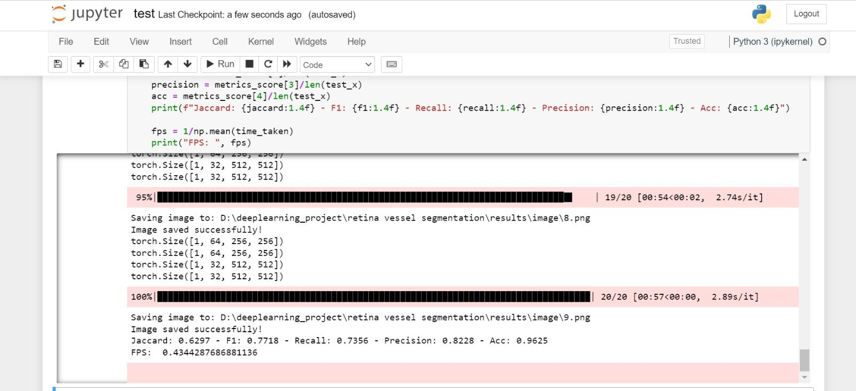
Training
Testing

Slide 7
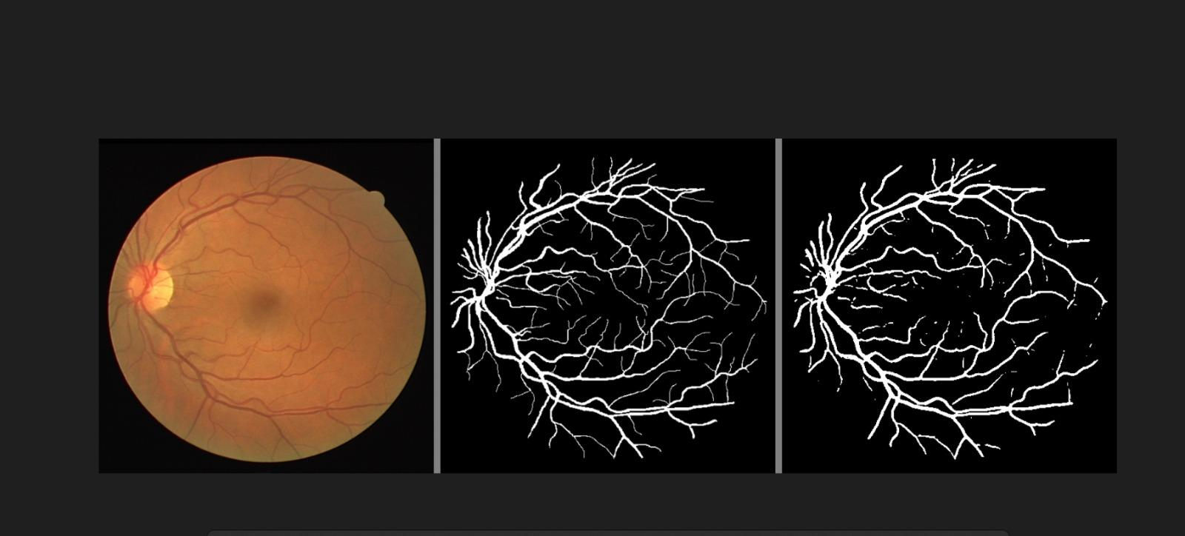
Results
Original Image
Ground truth mask
Predicted mask

Slide 8
Dataset
→Digital Retinal Images for Vessel Extraction (DRIVE) was used
→80% image used for training and 20% image used for testing
→https://www.kaggle.com/datasets/abdallahwagih/retina-blood-vessel
Research paper
→ https://drive.google.com/file/d/1Adr0KehTQgmYwbptzQuRf4Dy15w-PLzt/view

Slide 9

Conclusion
The proposed lightweight attention-based U-Net significantly improves retinal image segmentation with promising metrics. Leveraging dual attention modules enhanced model capability. Utilizing Adam optimizer with BCE+DiceLoss led to remarkable metrics: Jaccard= 0.6297, F1= 0.7718, Recall= 0.7356, Precision =0.8228, and Accuracy =0.9625, demonstrating robust performance in retinal segmentation tasks.

Slide 10
Thanks!
daasd

